Slide 1

Resource Management
Javeria Waseem
BSCS-f19-a72
Section b

Slide 2
Introduction
Resource management is the process of pre-planning, scheduling & allocating your resources to maximize efficiency.
Resource management helps organizations optimize people, providing insights into their work loads, availability, project time requirements, skills and more

Slide 3
Background
Year | Author | Method | conclusion
2011 | E. Kotsovinos | Basic resource, Resource pools, Resource Management operation, Challenges | Managing resources at a large scale while providing performance efficient use hardware is a key challenge for any cloud management software.
2017 | Ramon Dos Ries Fontes | Resource forecasting, Resources leveling | practical validation is next step that includes critical implementation. Work include more larger and complex scenarios.
2014 | Author JG Andrew, S Buzzi | Analyze the performance, Proposed algorithm, Evaluate the performance | The controllers global view the network to take more informed decision for efficient resource management.

Slide 4
Cont..
Year | Author | Method | Conclusion
2004 | M. Antonioletti, R. Baxter | Data, network ,software components ,functionality | Supported application and resources have been made to extend the scope compared to current research.
2013 | P. Benettin, Y.van der velde | Risk management tool, Measures, monitoring program's | The specific measures can be selected for each catchment taking under consideration management option evaluated Through computer simulation.

Slide 5
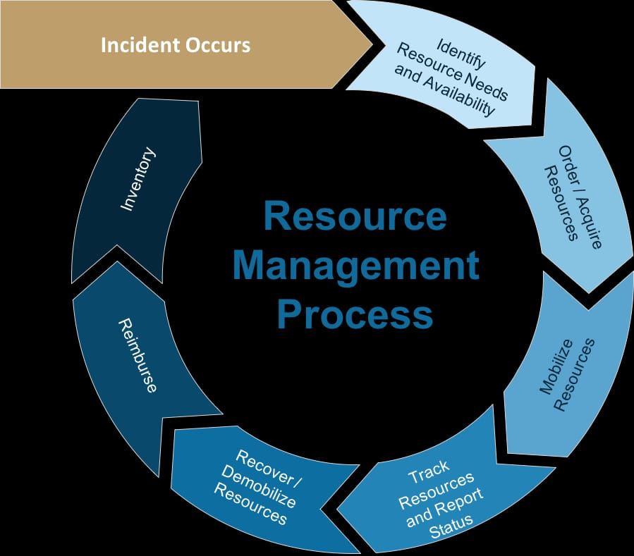
Methodology

Slide 6
Results
Optimal Utilization of Resources
Increase flexibility
Reduce risk
Improve project delivery
keep away from Unforeseen Challenges & Conflicts
improved insight into actual project costs

Slide 7
conclusion
Resource management is a skill set that every project manager must master, and with the right tools and techniques, it is easily achievable. Resource management solution allows planning, scheduling, and allocating resources effectively to projects while maximizing their profitable utilization. In a nutshell, it helps meet your project goals using your resources intelligently.

